Slide 1
Introduction to quantum computing
A QHardware Tutorial Series
Part-1

Slide 2
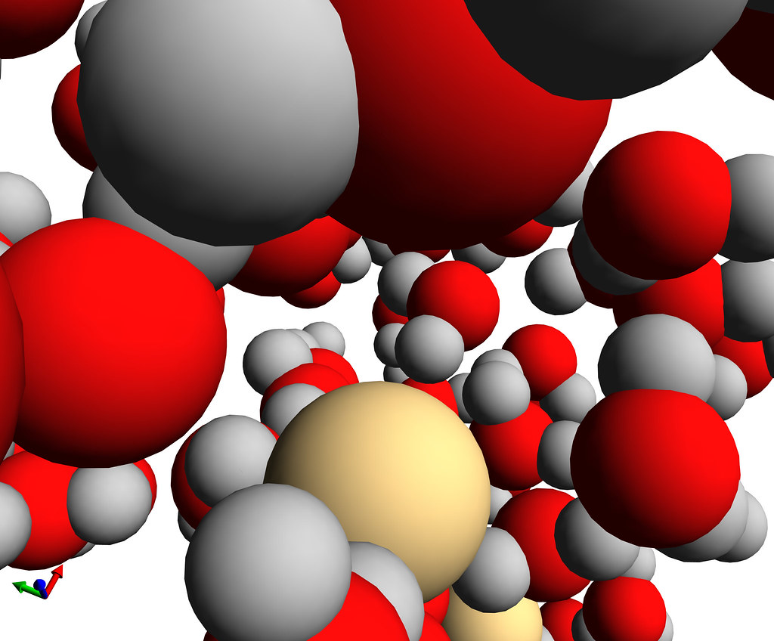
Quantum mechanics
A branch of physics that deals with the behavior of matter and light on the atomic and subatomic scale.
In classical mechanics, objects exist in a specific place at a specific time. In quantum mechanics, objects instead exist in a haze of probability; they have a certain chance of being at point A, another chance of being at point B and so on.

Slide 3
Postulates of quantum mechanics
Every physically-realizable state of the system is described in quantum mechanics by a state function that contains all accessible physical information about the system in that state.
Every observable in quantum mechanics is represented by an operator which is used to obtain physical information about the observable from the state function.
It is a general principle of Quantum Mechanics that there is an operator for every physical observable. A physical observable is anything that can be measured. If the wavefunction that describes a system is an eigenfunction of an operator, then the value of the associated observable is extracted from the eigenfunction by operating on the eigenfunction with the appropriate operator. The value of the observable for the system is the eigenvalue, and the system is said to be in an eigenstate.

Slide 4
Postulates of quantum mechanics
While the time-dependent Schrödinger equation predicts that wavefunctions can form standing waves (i.e., stationary states), that if classified and understood, becomes easier to solve the time-dependent Schrödinger equation for any state. Stationary states can also be described by the time-independent Schrödinger equation.
If two operators commute then both quantities can be measured at the same time with infinite precision, if not then there is a tradeoff in the accuracy in the measurement for one quantity vs. the other. This is the mathematical representation of the Heisenberg Uncertainty principle.

Slide 5
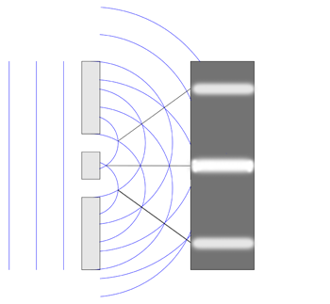
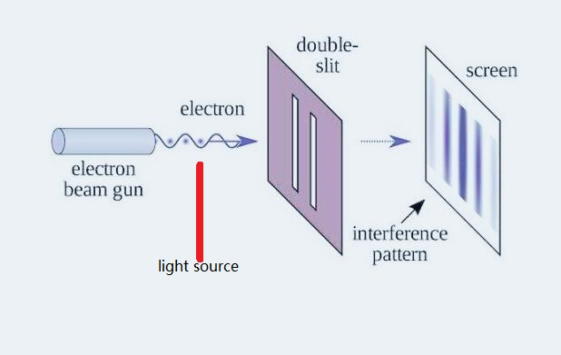
Double slit experiment
What does the experiment tell us?
It suggests that what we call "particles", such as electrons, somehow combine characteristics of particles and characteristics of waves.
That's the famous wave particle duality of quantum mechanics.
particles such as electrons are shot at a board with two slits cut into it, behind which sits a screen that lights up when an electron hits it.
If the electrons were particles, they would create two bright lines where they had impacted the screen after passing through one or the other of the slits
An interference pattern forms on the back screen. This pattern of dark and bright bands makes sense only if the electrons are waves, with crests (high points) and troughs (low points), that can interfere with one another
Video link: https://youtu.be/Q1YqgPAtzho

Slide 6
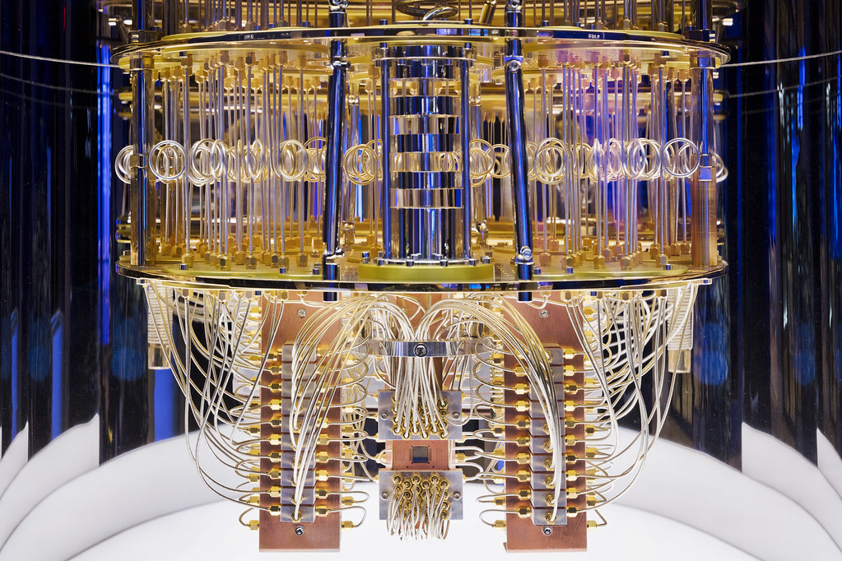
What is quantum computing
Quantum computing is defined as a computational technology that uses the principles of quantum mechanics such as entanglement, superposition, and interference to process, store, and manipulate large amounts of data and perform complex calculations for conventional computing systems and supercomputers to fathom.
Today’s ordinary computers run on chips that use bits for computations. These bits take either of the two values–zero or one–where zero represents the ‘off’ position, and one represent

Slide 7
How quantum computer works
Quantum computers work on qubits.
These represent quantum-mechanical systems that can take up different quantum values and scale exponentially beyond the conventional ones and zeros.
For example, a two-qubit system can perform four concurrent computations, while a three-qubit does eight, and a four-qubit system does 16.ts the ‘on’ position.

Slide 8
superposition
Superposition implies that the quantum system is capable of being in several different states at the same time.
For example, consider a coin toss scenario. When you flip the coin, it ends up as heads or tails. However, if we consider the state of the coin when it is suspended in the air, it holds both heads and tails simultaneously.
Similarly, quantum particles such as electrons are in a state of quantum superposition until they are measured. As a result, the ‘uncertainty’ factor is taken care of in quantum computers.

Slide 9
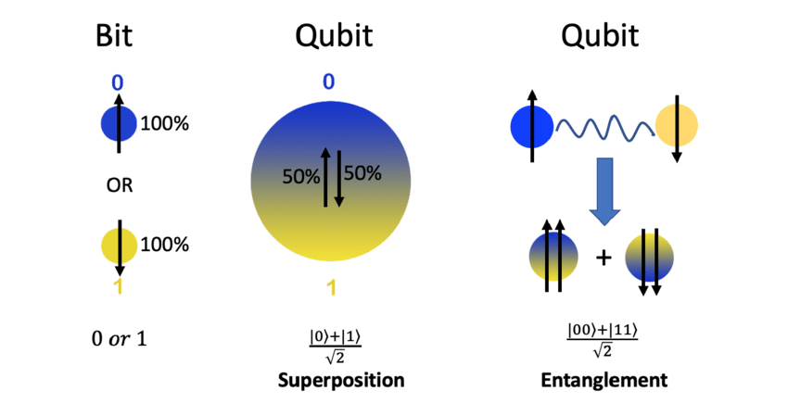
Superposition and entanglement

Slide 10
Entanglement
Entanglement refers to the entangling two or more qubits by establishing a correlation between them.
When qubits are entangled, any change to one of the qubits invariably impacts the others without exception.
For example, let’s say you introduce an additional qubit to a 60-qubit computer.
In such a case, the quantum computer can evaluate 260 states concurrently.
Adding a qubit along with the entanglement property allows the computer to perform computations faster than usual.
Hence, quantum computing algorithms use quantum entanglement for faster data processing.

Slide 11
Interference and coherence
Interference is a method of controlling the quantum states in a quantum machine by reinforcing or diminishing the wave functions of quantum particles. As a result, quantum states leading to a correct output can be amplified, while one can subsequently cancel the states yielding a wrong output.
Considers qubits and creates quantum superposition for all possible quantum states.
The encoder applies phases to each quantum state and configures the qubits. For the possible sitting ways that fall in phase, the amplitudes add up, while for the out-of-phase ways, the amplitudes cancel out.
The quantum computer then uses interference to reinforce or amplify some answers and cancel or diminish the others. As a result, a single solution for optimized seat allocation is finally reached.

Slide 12
References
1. Qiskit Textbook- https://qiskit.org/learn/
2. A Quantum Engineer's Guide to Superconducting Qubits (https://arxiv.org/abs/1904.06560)
3. Quantum Computation and Quantum Information by Michael A. Nielsen and Isaac Chuang
4. Principles of Superconducting Quantum Computers by Daniel D. Stancil and Gregory T. Byrd
5. Introduction to Quantum Mechanics by David J. Griffiths

Slide 13
Thanks

